Slide 1
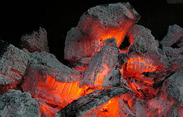
SMOULDERING FIRES
Sajeesh Nair

Slide 2
Contents
INTRODUCTION
DESCRIPTION OF DEFECT
SMOULDERING FIRE MECHANISM
MODELLING ASSESSMENT
RESULTS
CONCLUSION

Slide 3
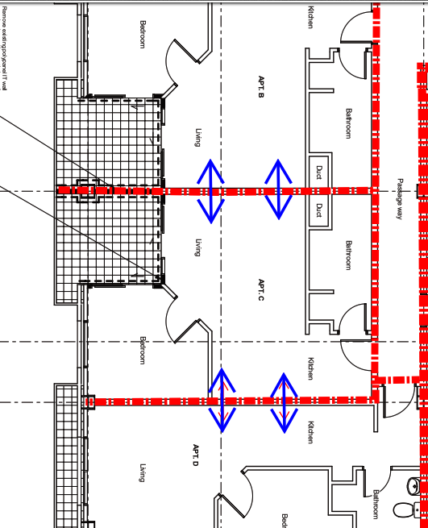
INTRODUCTION
Type 7 alarm system (Type 5 in Apartments)
Existing Building with Passive Fire Defects
Modelling was done to examine the impact on occupants due to smoke spilling into adjacent apartments if defects were not fixed
C/VM2 Sprinkler Controlled fire
Smouldering Fire (Lots of smoke. Doesn’t activate sprinklers or building evacuation)

Slide 4
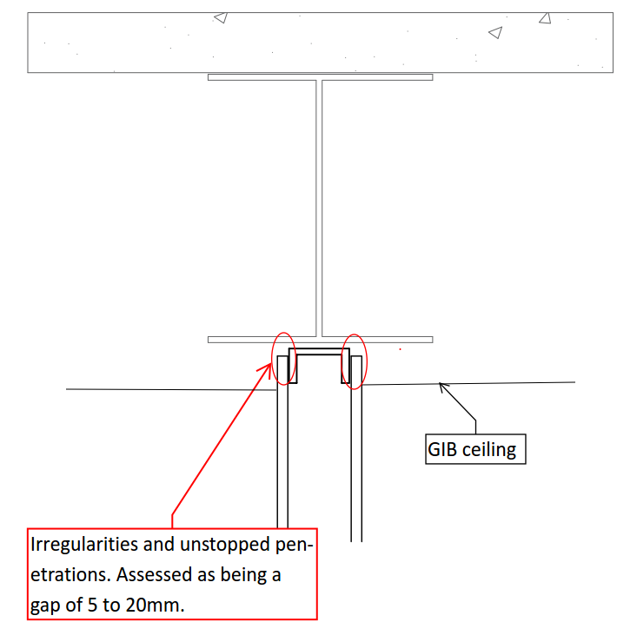
PASSIVE FIRE DEFECT IN INTERTENANCY WALL

Slide 5
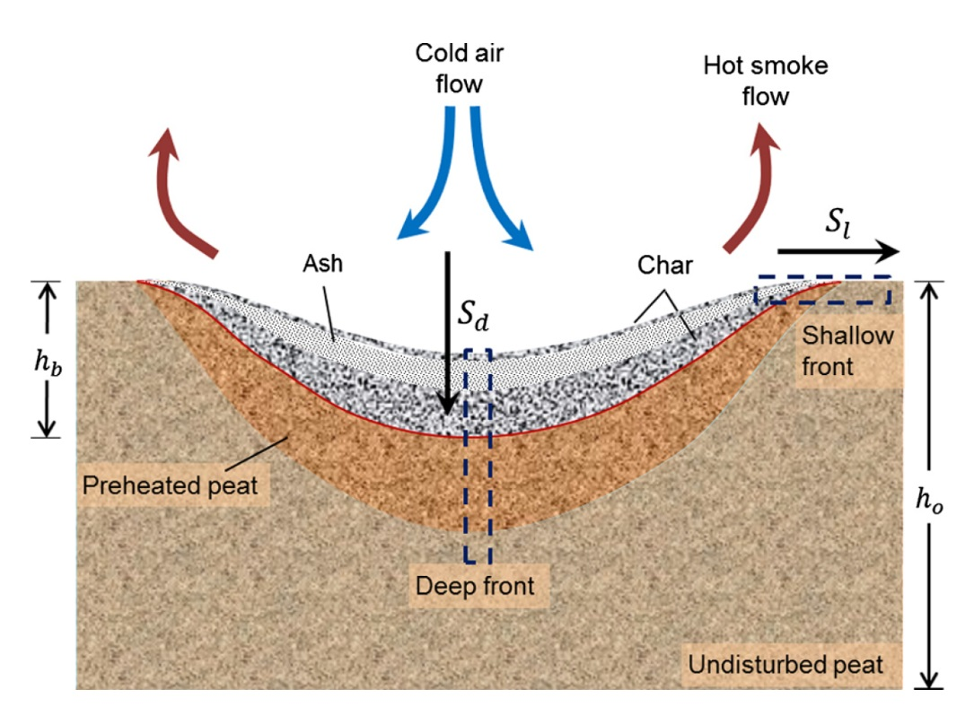
SMOULDERING FIRE MECHANISM
Smouldering is slow, low temperature, flameless form of combustion where heat is released when oxygen directly attacks the surface of solid fuel. Common in porous fuels which form a char on heating (cellulosic insulation, polyurethane foam)
Ref: SFPE Handbook of Fire Protection Engineering, 5th Edition, Chapter 19 - Smouldering Combustion

Slide 6
SMOULDERING FIRE CHARACTERISTICS
lower temperature and spread rate compared to flaming combustion.
Effective heat of combustion is in range from 6 to 12MJ/kg .
Heat Release Rate Per Unit Area(HRRPUA) on burning front – 10 to 30kW/m²
Larger Duration (1 hour to 3 hours for single bedroom compartment)
Buoyant plume is weak due to low heat release rate and smoke may not reach the ceiling
Ref: SFPE Handbook of Fire Protection Engineering, 5th Edition, Chapter 19 - Smouldering Combustion

Slide 7
SOURCES OF INFORMATION (SFPE Handbook 5th Ed)
A mattress fire is considered as it can provide fire with a slow growth rate but burn for a long time. The peak HRR is 40kW for cotton padding material(SFPE Handbook 5th Ed, Table 26.15)
The peak HRR for mattresses which smouldered were in the range of 26kW to 60kW (SFPE Handbook 5th edition Table 26.17).

Slide 8
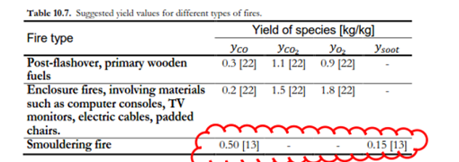
SOURCES OF INFORMATION (Lund University)
Lund University (Ref: Staffansson.L.(2010). Selecting design fires. Department of Fire Safety Engineering and Systems Safety, Lund University, (refer Section 10.1)).
Expected Peak Heat release rate(after 1 hour)

Slide 9
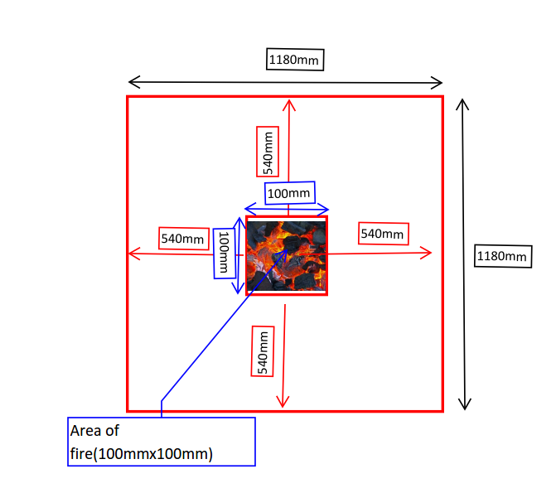
CHOSEN SMOULDERING FIRE CHARACTERISTICS
Spread rate of 9mm/min (instead of 6mm/min)
After 1 hour – spread up to 540mm
Total area affected 1.18mx1.18m=1.39m²
For HRRPUA of 30kW/m²
Peak heat release rate
=30kW/m²x1.39m² = 42kW

Slide 10
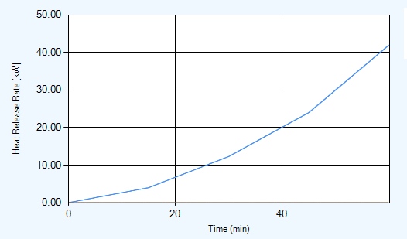
SMOULDERING DESIGN FIRE
Peak heat release rate 42kW
HRRPUA of 30kW/m²
Δ Hc = 12MJ/kg
Ysoot = 0.15 kg/kg
Yco = 0.5 kg/kg

Slide 11
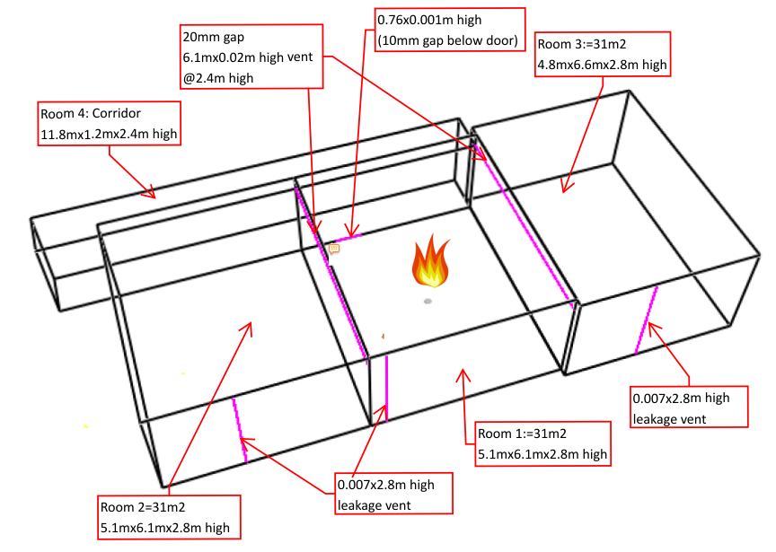
SMOULDERING FIRE – B-RISK MODEL
Intertenancy Wall gaps
5mm high
10mm high
20mm high

Slide 12
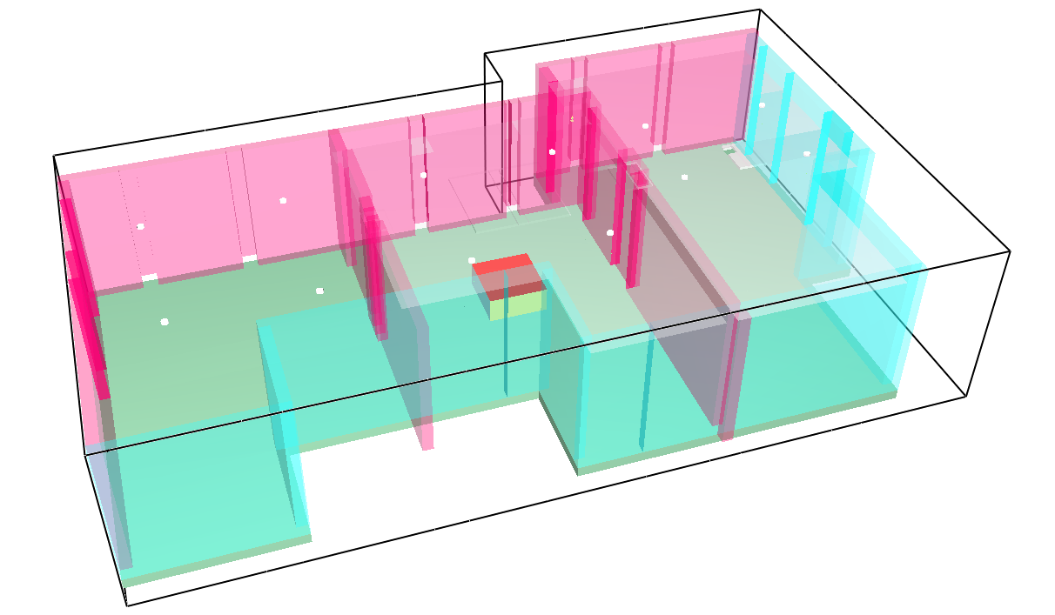
SMOULDERING FIRE – FDS MODEL
Recessed lights in the GIB ceiling appear to be well sealed but 50% leakage is assumed around the light fittings to be conservative.

Slide 13
RESULTS
Smouldering fire (B-Risk Model)
Smouldering fire (FDS Model)
Vent Size | Adjacent Unit Smoke detector activation time | Adjacent Unit ASET(s) | ASET – Smoke Detection time
5mm vent | 24mins | 46.6mins | 22.6 mins
10mm vent | 23.5mins | 45.8mins | 22.3 mins
20mm vent | 21.6mins | 45.1mins | 23.5 mins
Vent Size | Adjacent Unit Smoke detector activation time | Adjacent Unit ASET(s) | ASET – Smoke Detection
20mm vent | 21.6mins | 43.3mins | 21.7 mins

Slide 14
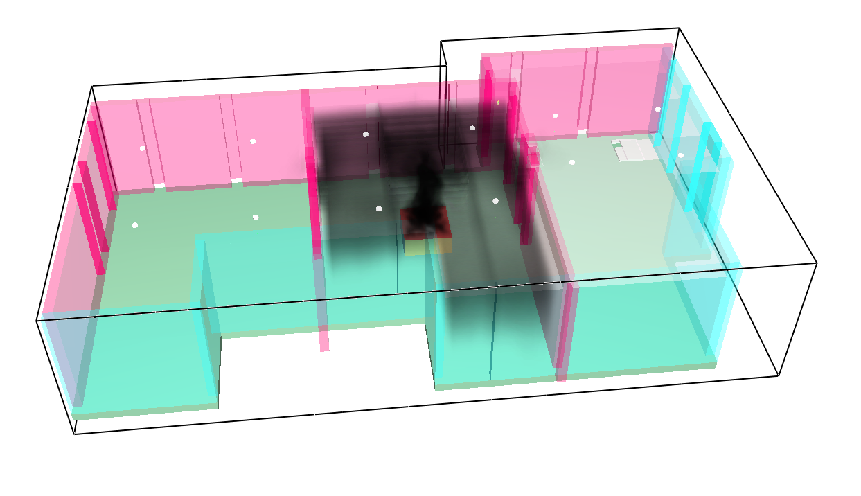
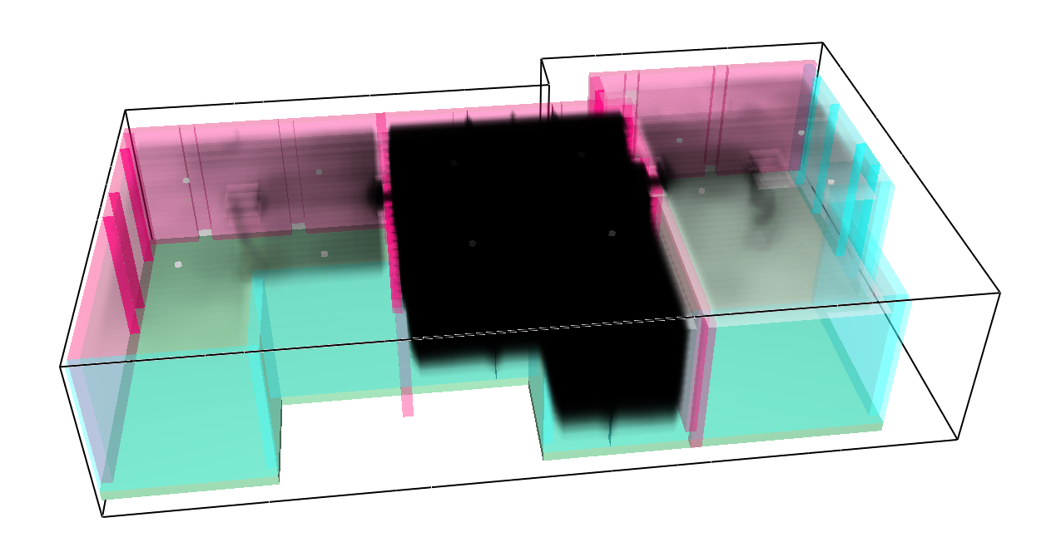
SMOULDERING FIRE – FDS Snapshots
3D Smoke output@4mins
3D Smoke output@15mins
3D Smoke output@30mins
3D Smoke output@46mins

Slide 15
SMOULDERING FIRE - CONCLUSION
Smouldering Fire assessment was carried out to increase our understanding of the risk faced by occupants in the adjacent units due to incomplete fire stopping works on intertenancy walls(5 to 20mm)
Smouldering fires are small and have slow growth rate due to low heat release rate.
Smouldering fires are small and have slow growth rate due to low heat release rate.
 | Smouldering fire | C/VM2 fire
Effective Heat of Combustion (ΔH_{c}) | 6-12MJ/kg | 20MJ/kg
CO yield | 0.5kg/kg | 0.04kg/kg (preflashover) 0.4kg/kg (postflashover)
Soot Yield | 0.15kg/kg | 0.07kg/kg (preflashover) 0.14kg/kg(postflashover)

Slide 16
SMOULDERING FIRE - CONCLUSION
The increase in vent size resulted in more smoke spilling into adjacent apartment and earlier activation of smoke detectors.
There is approximately 22 minutes available for evacuation of occupants in the adjacent apartments after their smoke detector activates before conditions become untenable which is a considerable amount of time for egress compared to the 5 minutes C/VM2 premovement time.

Slide 17
THANK YOU!
See you soon :)

