Slide 1
Fire Engineering for KiwiBuild 防火工程服务于KiwiBuild
High Quality Low Cost Homes
低成本高质量的建筑

Slide 2
CONTENTS 目录
Introduction 前言
Basic fire safety principles 消防安全的基本原则
Expensive designs to avoid 避免采用昂贵的设计
Design it right build it right 合理设计合理施工
Conclusion 总结

Slide 3
WHO WILL LIVE IN KIWIBUILD? Kiwibuild是为谁建的？
Children儿童
Elderly长辈
Families 家人

Slide 4
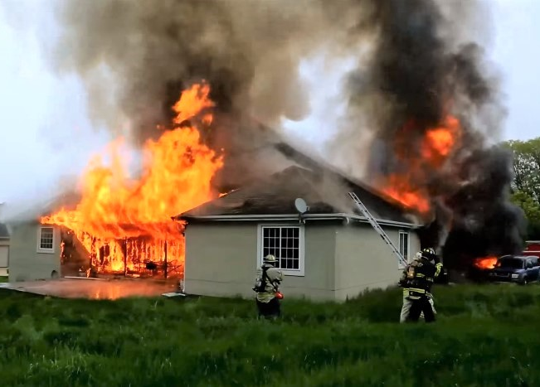
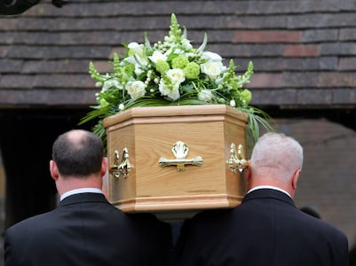
THE STATS? 据统计
3500 FIRES PER YEAR
每年新西兰有3500起大火
20 DEATHS PER YEAR
每年有20人在大火这丧失生命

Slide 5
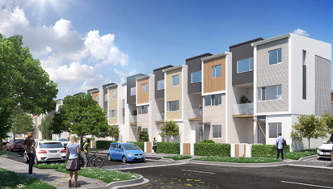
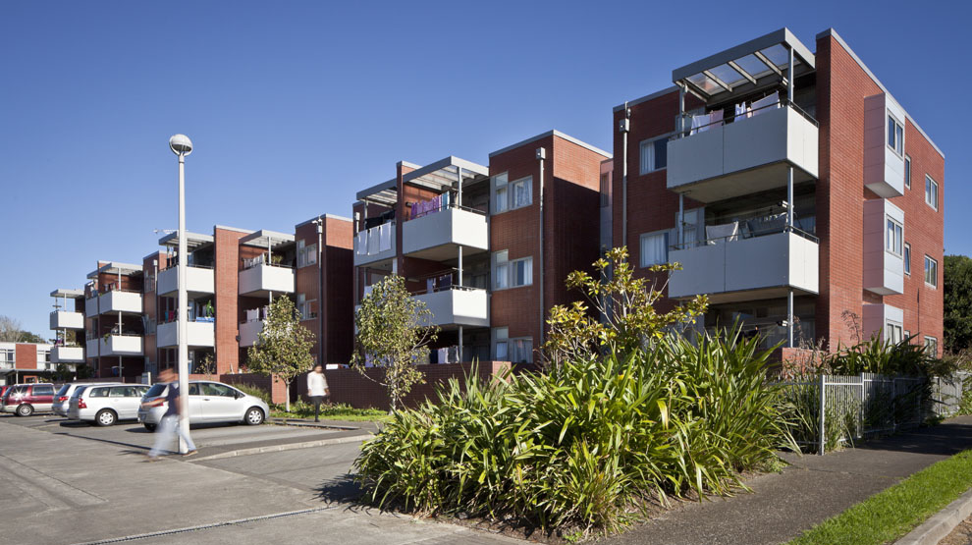
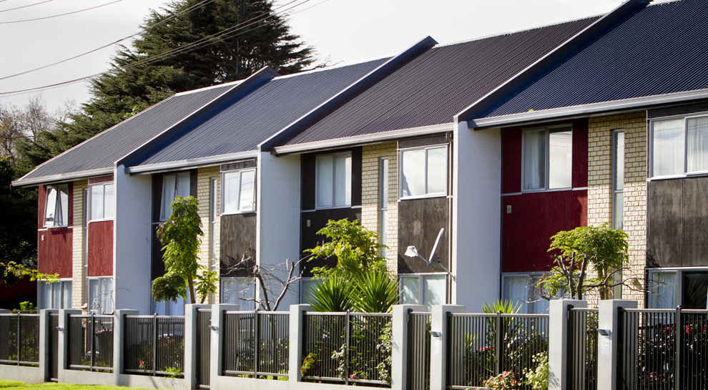
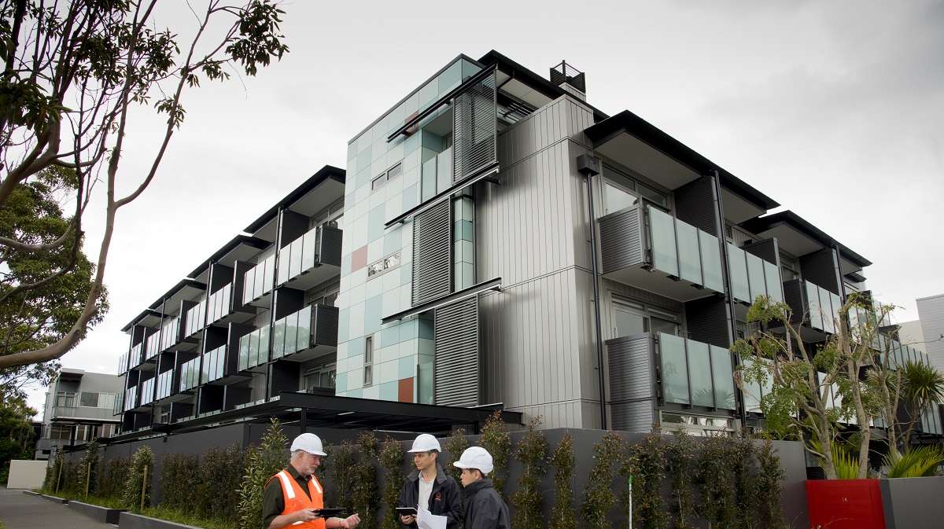
WHAT WILL THEY LIVE IN? 他们会住进一些什么样的建筑？
Terraced Houses 联排别墅
Apartments 公寓

Slide 6
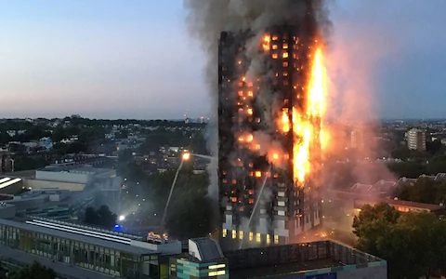
GETTING IT WRONG FOR HIGH DENSITY 在高密度建筑上犯错误
70 DEATHS IN ONE GO 一次死亡人数70人
FIRE SAFETY IS IMPORTANT!!
防火安全非常重要

Slide 7
FIRE ENGINEERING GOALS 消防工程目标
Building Act 2004 建筑法 2004
Ensure people can escape a building in case of fire.
确保人们可以在发生火灾时逃离建筑物
Building Code 建筑规范
safeguard people from an unacceptable risk of injury or illness caused by fire,
避免人们受到火灾造成的不可容忍的伤害或疾病的风险
(b) protect other property from damage caused by fire, and
保护其他财产免受火灾造成的损害
(c) facilitate firefighting and rescue operations.
有利于消防和救援行动

Slide 8
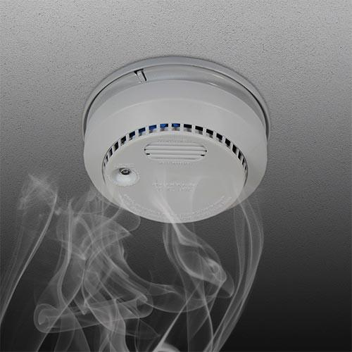
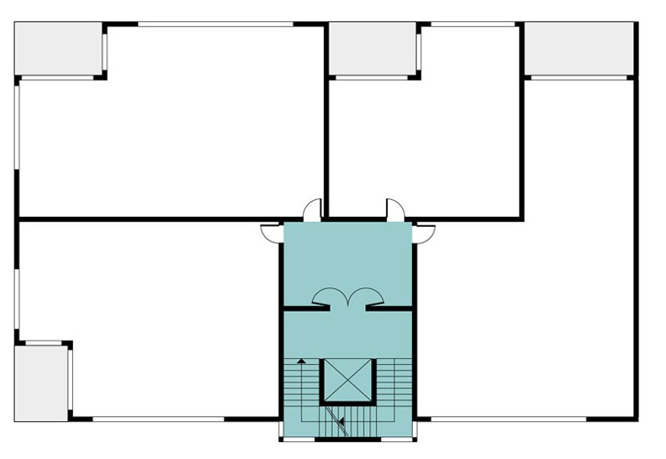
BASIC PRINCIPLES 基本原则
Early Warning
及时警报
Simple /safe escape routes
简单/安全的逃生线路
Image – Auckland Council design manual

Slide 9
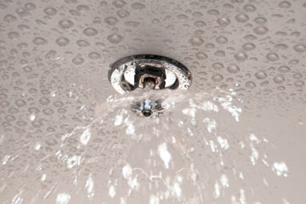
BASIC PRINCIPLES 基本原则
Control the Fire
控制火势
Stop it spreading
阻止火势蔓延

Slide 10
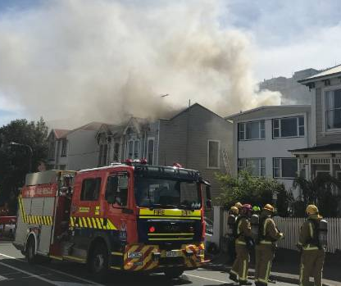
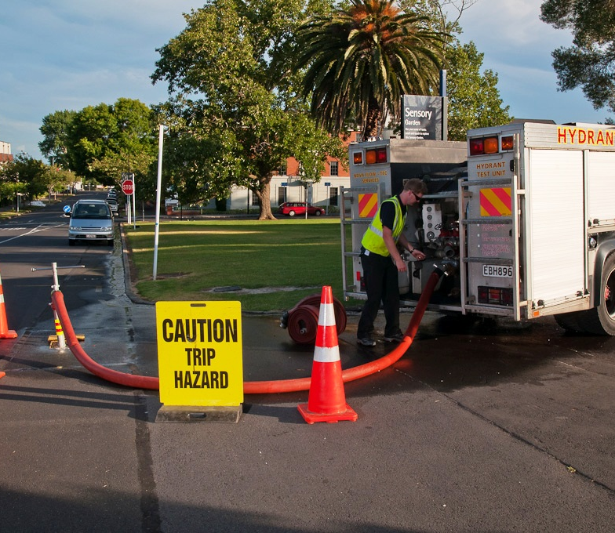
BASIC PRINCIPLES 基本原则
Fire Fighter Access
消防车最短的通道
Water supply
有效水源

Slide 11
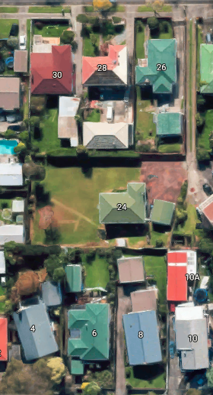
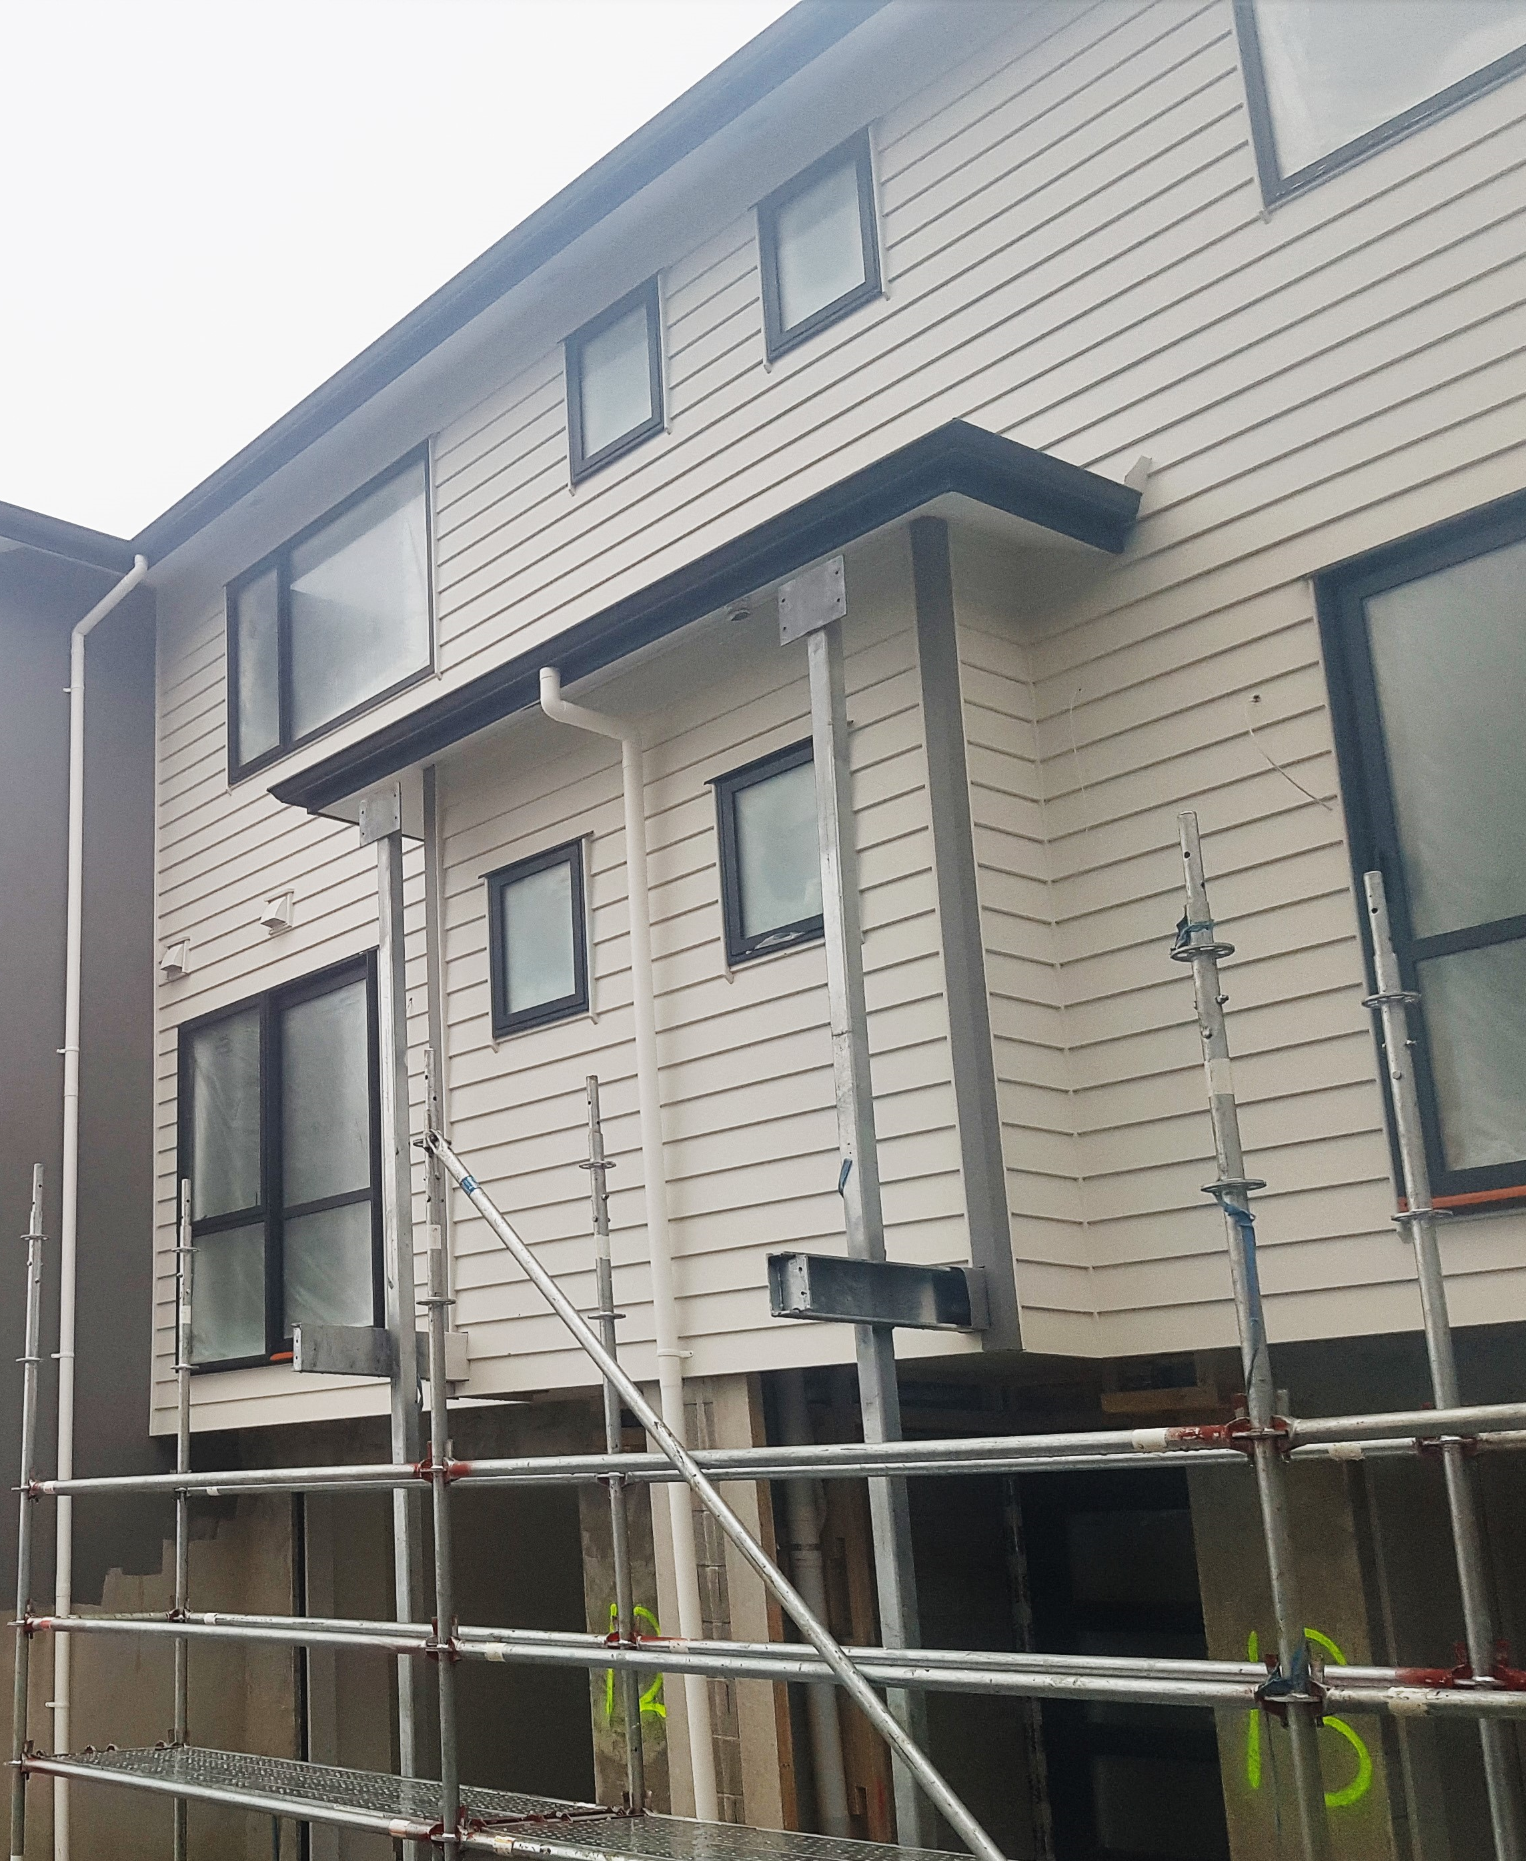
EXPENSIVE DESIGNS TO AVOID 避免采用昂贵的设计
Down long narrow driveway
长而狭窄的车道
Cantilever lower roofs
悬臂式低屋顶

Slide 12
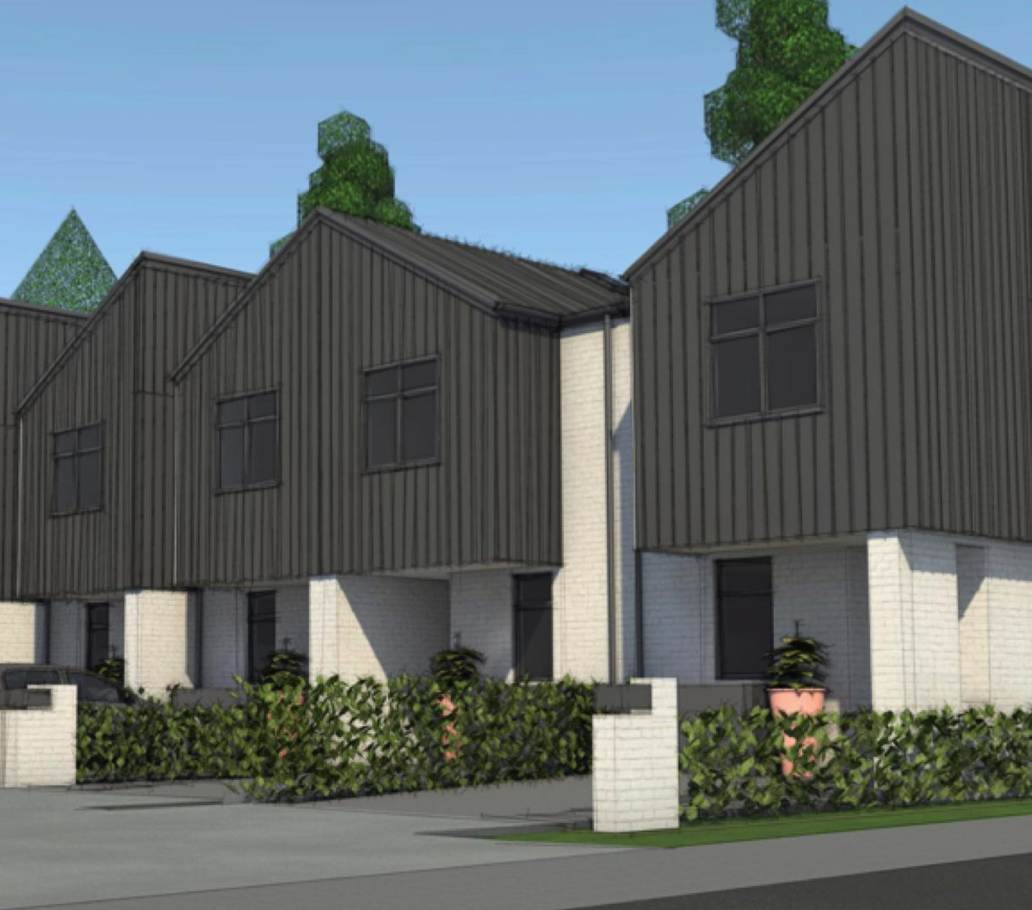
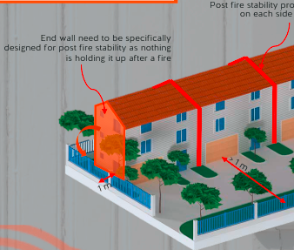
EXPENSIVE DESIGNS TO AVOID 避免采用昂贵的设计
Cantilever IT walls
悬臂式中间墙
End wall post fire stability
尽端墙火后的稳定性

Slide 13
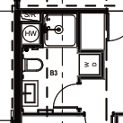
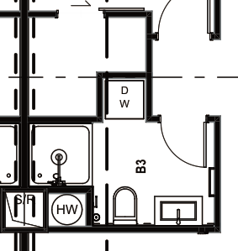
EXPENSIVE DESIGNS TO AVOID 避免采用昂贵的设计
Put all plumbing on firewall 将所有卫生洁具管道放到防火墙上
Expensive 昂贵
Smarter 更智能

Slide 14
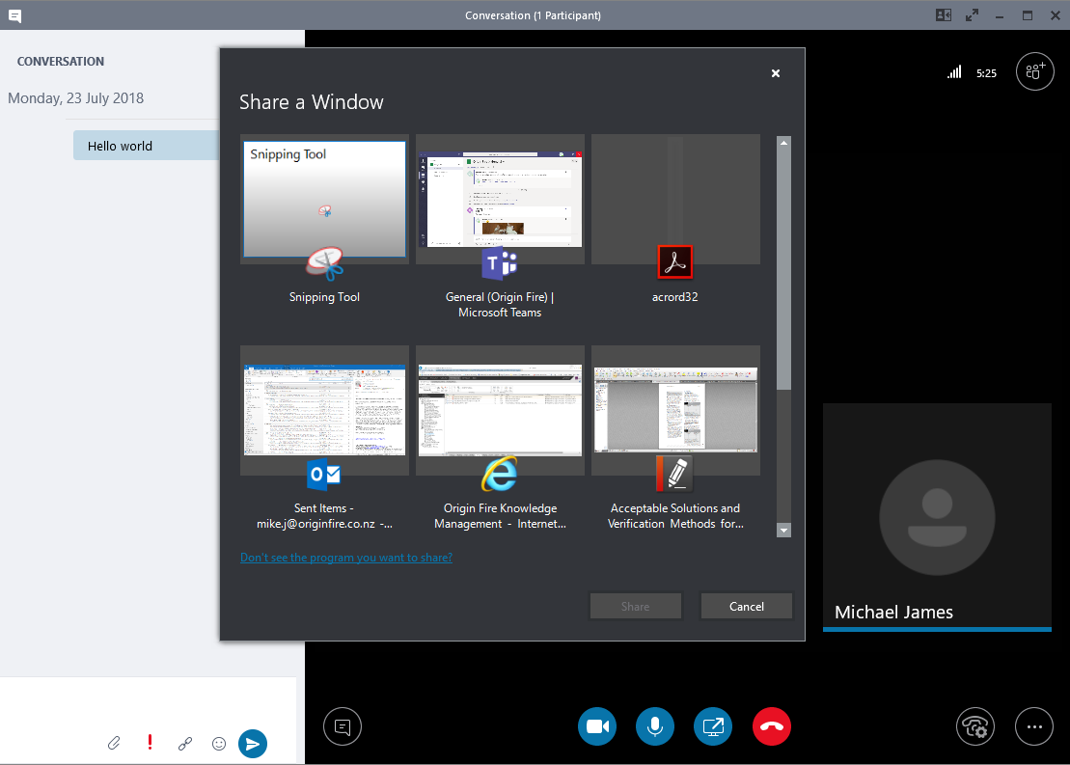
DESIGN IT RIGHT – BUILD IT RIGHT 合理设计 – 合理施工
Early Communication
提前交流
Regular Communication
定期沟通

Slide 15
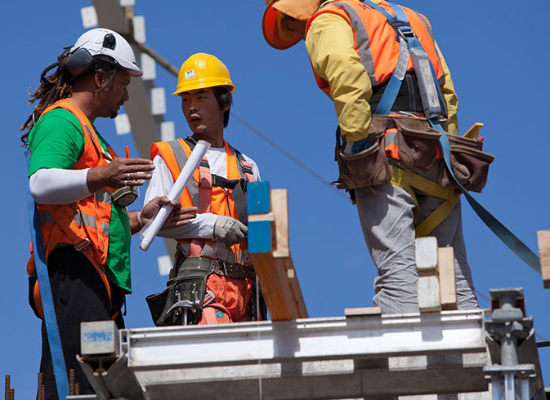
DESIGN IT RIGHT – BUILD IT RIGHT 合理设计 - 合理施工
Complete Building Document 完整的建筑文件
Don’t rely on the builder to guess how to design it.
不要依赖建造者来猜测如何设计
Draw all the details
绘制所有的细节
Full building services design
所有建筑专业工种的完整设计
Passive fire design
被动防火设计

Slide 16
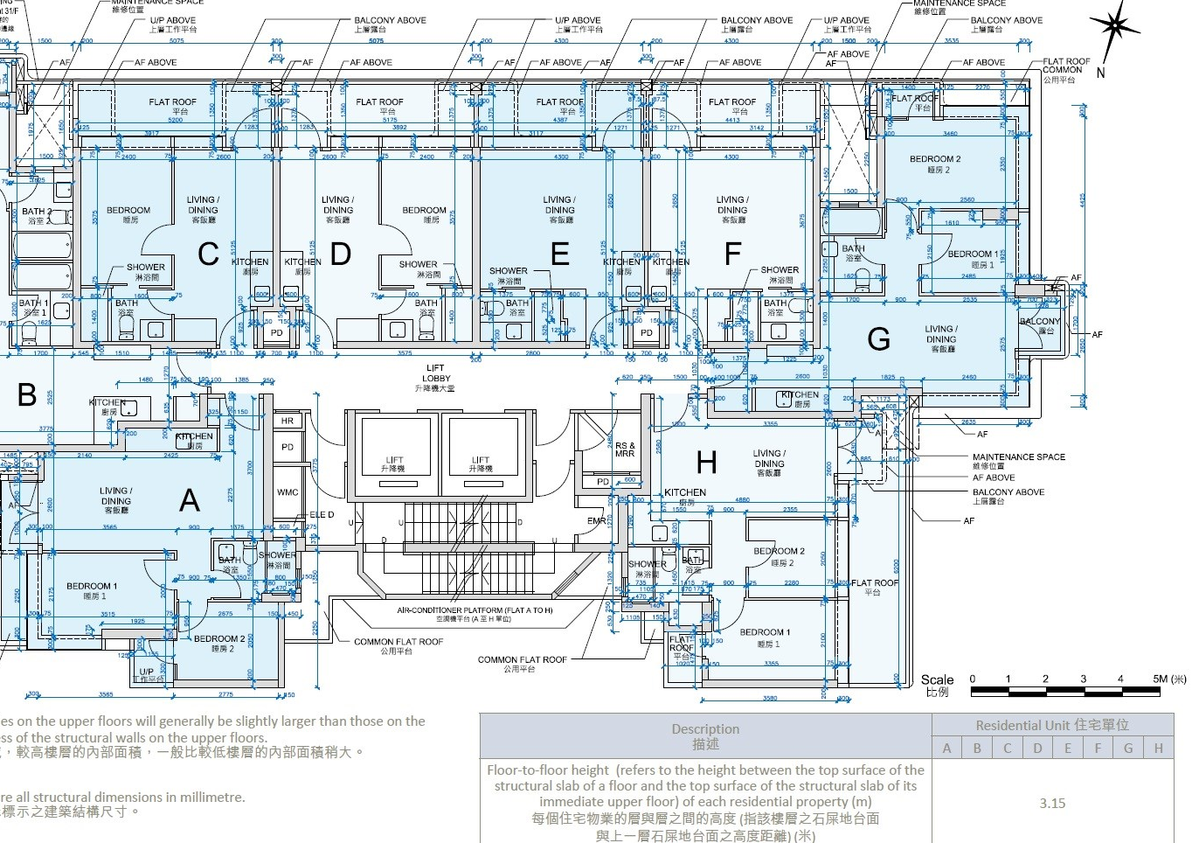
DESIGN IT RIGHT – BUILD IT RIGHT 合理设计 - 合理施工
Bilingual / Apps 双语 / Apps
Bilingual documents.
双语图纸和文档说明
Mobile Friendly Apps
同时适用手机操作
的Apps

Slide 17
DESIGN IT RIGHT – BUILD IT RIGHT 合理设计 - 合理施工
Build what is designed 完全按照设计来施工建造

Slide 18
CONCLUSION 总结
Smart Planning
智能规划
Clear Documentation
清晰的文档
Communication 交流沟通
Build to the plans 按图施工
COST EFFECTIVE FIRE SAFETY
利润最大化的安全防火

Slide 19
THANK YOU!
谢谢！
See you soon :)
希望很快会为您提供服务 ☺

